Slide 1
International Student Orientation Undergraduate Program
SPRING 2019

Slide 2
WELCOME!
Getting to know you!
Name
Home country
Major of study
Why Michigan?
What are your plans after completing your BBA degree?

Slide 3
Maintaining F-1 status

Slide 4
Understanding Your F-1 Visa
It is your responsibility to become familiar with the requirements and follow the regulations of your F-1 Visa.
https://www.ice.gov/sevis/students
https://studyinthestates.dhs.gov/maintaining-status
Do NOT rely on information from other international students, as each situation is unique to the student.
If you have questions, contact one of the DSOs at Cleary University.

Slide 5
Full Time Course Load
Enroll and maintain twelve (12) academic credits each semester
Do NOT Drop or Withdraw from a course
Attend ALL scheduled classes
Do not fail courses, if possible

Slide 6
Attendance
F-1 students are expected to attend ALL scheduled on-ground classes and successfully complete/pass ALL courses
F-1 Undergraduate students are required to physically attend on-ground courses
Attendance/participation is recorded
If a student takes at least 9 credits on-ground, then they are permitted to take one three (3) credit online course
Avoid “W” grades as they may result in F-1 status termination

Slide 7
Registration and Payment
Academic Advisors will assist with academic program planning
Students must register for twelve (12) academic credits each semester
Maintain F-1 status and adhere to registration dates and deadlines
Register and pay early to avoid a late fee
Pay in full or set up a payment plan with the Business Office
Business Office Contact Information
Phone: 517.338.3320
Email: businessoffice@cleary.edu
Website: http://www.cleary.edu/tuition-payment/

Slide 8
Form I-20

Slide 9
Keep EVERY Form I-20
The Form I-20 is an important document that should be kept safe, F-1 students need their Form I-20 for benefits:
Driver’s license
Social Security Number
Post-OPT
Change of Status
Form I-20 is a federal document and given the potential for fraud- ‘soft’ copies (scanned) copies are not permitted
Source: https://studyinthestates.dhs.gov/what-is-the-form-i-20

Slide 10
Program End Date
If you are unable to complete your program by the end date listed on your I-20, you may apply for an extension before the program end date
Contact a P/DSO at least three (3) months before your end date to discuss the extension process
Conditions:
Students must be continuously maintaining their F-1 status
F-1 students must be in good academic and financial standing with the University

Slide 11
Before….
Graduating - contact a P/DSO at least two (2) weeks before the start of your final semester
Changing program / major - contact a P/DSO at least two (2) weeks before the start of your next semester
Traveling outside of the U.S. - contact a P/DSO at least two (2) weeks before you book your ticket or make travel plans- a Travel Endorsement Signature is required on the Form I-20
Dropping a course - Do NOT drop or withdraw from a course. Speak to a P/DSO or Academic Advisor immediately for guidance

Slide 12
Reporting Requirements
Please report within ten (10) days of the change:
Address
Telephone
Name changes; marriage or spelling has changed on passport
Financials or sponsorship
Status changes from F-1 visa to a different visa- H1B, B-2, etc.
Passport/F-1 visa renewals
There is a penalty for not reporting changes in a timely fashion
Note- Passport needs to be valid for six (6) months or more at all times

Slide 13
Employment

Slide 14
F-1 Students and Employment
Types of Employment:
On-Campus Employment
On school premises- student positions such as peer tutors, servers with dining services, Graduate Assistants, etc.
May work up to 20 hours per week while school is in session ( full time during those periods when school is not in session or during the annual vacation)
Curricular Practical Training (CPT)
Written approval from P/DSO is needed before an F-1 student can start working
For UG Students CPT must be taken for credit, student must enroll in INT course, to be eligible for CPT
Optional Practical Training (OPT)
Adjudicated by U.S. Citizenship and Immigration Services (USCIS)
Any other employment in the U.S. is considered Unauthorized Employment- F-1 student status will be terminated if a student is found working outside of their visa requirements

Slide 15
CPT Information
Successfully complete at least one (1) academic year
During the semester, student is only eligible for part time CPT
During Summer/ Vacation Semester a student could work CPT full time with enrollment in the INT course.
Meet and maintain satisfactory GPA requirements (2.0 or higher)
The CPT position must be directly related to the major of study and augment the student’s studies

Slide 16
CPT Information
A job offer letter must be presented, and approved by a school P/DSO prior to starting CPT position
To avoid F-1 status termination, due to ‘unauthorized employment’ - do not start the CPT position before authorization has been given and a new CPT I-20 is printed
Offer letter should be on company letterhead and include the following:
Employer Name
Job Title
Job Description
Company Address
Start/End dates of employment
Employment status Full time/Part time

Slide 17
Part-time vs. Full time Employment
Part-time is 20 hours or less per week
No limitation on part-time CPT experience, as long as the student remains eligible to continue classes
Full time is any time over 20 hours per week
365 days or more of full time CPT employment makes a student ineligible for OPT at this degree level
Full time CPT is only permitted during a Vacation/ Summer semester
NOTE: If a student is only approved for part-time CPT employment, and works over 20 hours per week this may affect their F-1 status or change of status petition in the future

Slide 18
Student Tax Return
Every international student and their dependents are required to file their tax return if they were in the US during the previous calendar year.
You might get a refund - Some international students will qualify for a refund due to tax treaties and a lack of serious income if they’ve earned income in the US.
You fulfill your visa obligations - All international students must file at least Form 8843 in order to remain legal under F visa, even if you didn’t earn any money in the US.
Source: https://www.internationalstudent.com/tax/

Slide 19
Adjusting to Life in the U.S.

Slide 20
Health Insurance
Insurance is essential and required for Cleary University students.
Healthcare can be very expensive but life saving!
Health Insurance will help save money in the long-term
There are several health insurance companies that service international students:
International Student Insurance
iNext Health Insurance

Slide 21
Housing
Campus Residence Hall
North Hall
South Hall
Houses vs Apartments
Own
Rent- roommates, classmates, friends or family
Try to avoid Craigslist, if possible

Slide 22
Transportation
Public Transport – L.E.T.S Bus
Private Transport –
MI driver’s license, insurance, registration - required
Renting – Hertz, Budget, Enterprise, Penske
Borrowing from family/friend – check on their insurance coverage
Leasing
Purchasing
Retail price, delivery fee, taxes, title and registration
Car dealership; new or used, Private seller, Auction, Person you know, Car Repair Shop
Purchase costs, upkeep (tires, oil change, etc), gas, yearly costs (registration and insurance)

Slide 23
Cell Phone Providers
Verizon
T-Mobile
AT&T
Sprint
Boost Mobile
Cricket

Slide 24
Financial Accounts
Banks: for-profit enterprises
PNC
Comerica
Bank of America
Chase
Credit Unions: non-profit
University of Michigan Credit Union
DFCU
Notes:
Credit Union- Higher interest rates on deposits (earn a little $), Lower Loan & Credit Card Rates, lower fees, customer service focused. Minimum balance requirements- locations are limited coop credits or fees assessed.
Banks- more locations, easier transactions (online or Mobile), higher fees

Slide 25
Getting Started

Slide 26
Cleary Student Email
Access email https://mail.google.com.
Username: first initial + up to first 10 letters of your last name + last three digits of your student ID number +@my.cleary.edu
Password: cleary + two digit birth month + two digit birth day
Technical Support
Email: support@cleary.edu

Slide 27
Canvas Access
Access Canvas: https://cleary.instructure.com/login/canvas
Username: first initial + up to first 10 letters of your last name + last three digits of your student ID number +@my.cleary.edu
Password: cleary + two digit birth month + two digit birth day
Canvas is Cleary University’s online learning management system (LMS)
All of your course content is maintained in Canvas
Videos
Watch this video for step-by-step Canvas login instructions
Students across the University are encouraged to watch this Student Experience video to get a sense for the functionality and layout of Canvas.
Technical Support
Email: support@cleary.edu

Slide 28
Canvas Access
Access Canvas: https://cleary.instructure.com/login/canvas
If a student can't see their courses in their Canvas dashboard, follow the written instructions below or watch this video for step-by-step instructions to adding course(s) to your Canvas Dashboard.
Log into Canvas
Select Courses from the left, blue side bar menu
Visually locate your courses for the next semester, then select the Star icon next to the course to change the color of the star
Select Dashboard to view your course
Technical Support
Email: support@cleary.edu

Slide 29
Student Portal
Access the Student Portal: https://students.cleary.edu
Username: first initial + up to the first 10 letters of your last name + last three digits of your student ID number
Password: cleary + two digit birth month + two digit birth day
Student Schedule
Financial Aid Statement
Tuition Statement
Grades
Edit Student Profile & Passwords
Registration
Technical Support
Email: support@cleary.edu

Slide 30
Textbooks
MBS Direct
http://bookstore.mbsdirect.net/cleary.htm
Textbooks may be ordered from the Cleary University Bookstore provider- MBS Direct or any other provider of your choice. Visit the Cleary University homepage to review the current textbook listings.
Bookstore Contact Information
Phone: 517.338.3043
Email: bookstore@cleary.edu
Website: http://www.cleary.edu/bookstore/

Slide 31
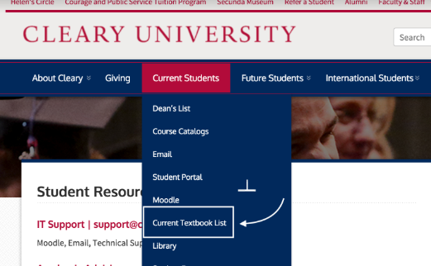
Textbooks
To view the full current textbook listings - Cleary.edu webpage > Current Students > Current Textbook List

Slide 32
How to Prepare for class
Access to Classes – One week prior to starting
Instructor contact information
Review course syllabus:
Course learning outcomes
Textbook(s)
Course structure
Course grading criteria
Review first week’s assignments
Know deadlines
Ask instructors clarifying questions

Slide 33
Important Dates
Spring 2019 Semester
1/7/19 – 5/5/19
Spring break
3/4/19 – 3/10/19
Final Exam week
4/29/19 – 5/5/19
Semester Break
5/6/19 – 5/12/19
The academic calendar is located on the Cleary University homepage found here: https://www.cleary.edu/academic-calendar/

Slide 34
Academic Services
Academic Advising
Academic Tutoring – Undergraduate students only
Career Development
Technical Support
Counseling Services
Spiritual Life Director
Writing Center
University Instructional Librarian

Slide 35
Student Resources
If you fall behind in a course:
Contact instructor
Contact an academic advisor
Student Success Center
Tutoring one hour free per week/ per class
Disability Resource Center
Writing Center
Seek out other resources:
Attend free seminars
Study Skills
Test Taking Skills and Anxiety Prevention
Make friends with classmates and study together

Slide 36
What is APA style?
APA format is the official style of the American Psychological Association (APA)
Standardized style of writing, used to cite sources in psychology, education, and the social sciences
APA Tutorials
APA & Writing Resources available on the Library Website
http://cleary.libguides.com
Publication Manual of the American Psychological Association
www.apastyle.org
Purdue OWL
https://owl.purdue.edu/owl/research_and_citation/apa_style/apa_style_introduction.html
Citation Generators and Reference Managers
Noodletools
KnightCite
Zotero

Slide 37
Writing Center
Face-to-Face and online assistance via the Canvas Writing Center
30 minute sessions are scheduled within the Writing Center using the Canvas Calendar
Help with…
Writing project in any class
Polishing
Rough Drafts
APA Style and citation
What to expect…
Improvement in overall writing abilities with repeat visits
Support for your writing abilities at any level of experience and at any stage of the writing process
Friendly and knowledge writing coaches
What not to expect…
An editing service
A perfect paper
Flawless writing coaches

Slide 38
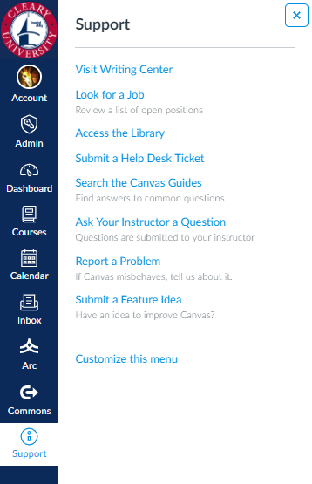
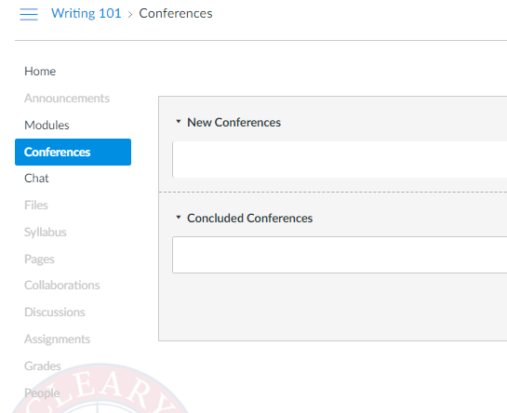
Writing Center
Log into Canvas > Support > Visit Writing Center
Writing Center How to Video for booking an appointment
Video
Online/Virtual sessions are delivered through the Writing Center Conferences

Slide 39
Any Questions?

